Slide 1
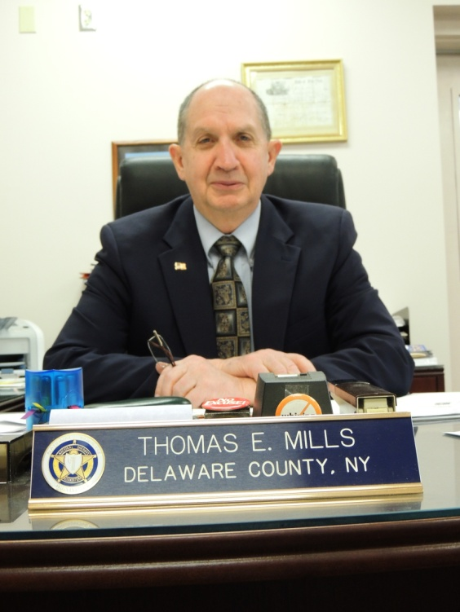
Delaware
County
Sheriff’s Office
2013 Annual Report
Sheriff Thomas E. Mills

Slide 2
Sheriff’s Office Divisions
Civil Division
Communications Division
Corrections Division
Law Enforcement Division

Slide 3
Civil Division
Service of Notices, Summons, Subpoenas, Petitions & Orders
Warrants of Eviction
Income and Property Executions
Court Orders
Pistol Permit Investigations

Slide 4
Civil Division - Activity
(585) Total Papers Served
(501) Income Executions Served
(4) Property Evictions Completed
(155) Orders of Protection Served
(444) Pistol Permit Investigations

Slide 5

Civil Division Fees – Revenue Collected
Fees Collected: $33,546.90
Poundage Collected: $39,859.16
Total Civil Revenue: $73,406.06
*2.86% Increase over 2012

Slide 6
Communications Division
24/7 Dispatch and Communications Service to include various County agencies, State Agencies, Towns and Villages.
Maintenance of Computer Aided Dispatch Service (CAD) for all agencies served.
Supports Several Local Police & County Departments.
15,385 CAD Incidents for 2013
8,551 CAD Incidents for other County, State and/or Law Enforcement Agencies.

Slide 7
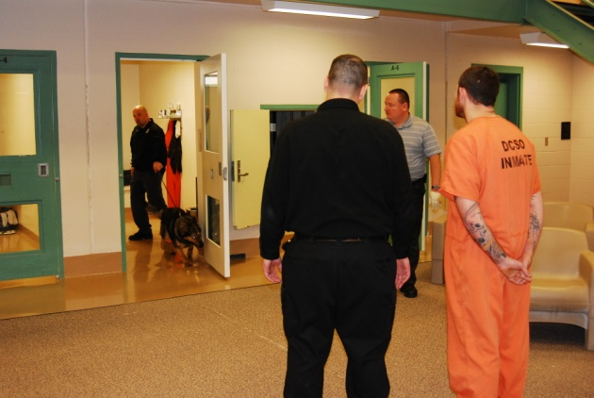
Corrections Division (Jail)
103-Bed Correctional Facility
(3) Male Pods, (1) Female Pod
Operations and Classification mandated by the NYS Commission of Corrections.
1,732 Inmates Processed in 2013 – Up (68) from 2012.
Average Jail Population 85 Inmates. (80 in 2012)
763 Jail Transports; Up from (700) average in previous years.
            Revenue
$562,967 in revenue for boarding fees in 2013; $462,937 above projected budget.
40.73% Increase in Board-In Revenue 2012 – 2013.
$3.1 Million Total Board-In Revenue Since Jail Inception.

Slide 8
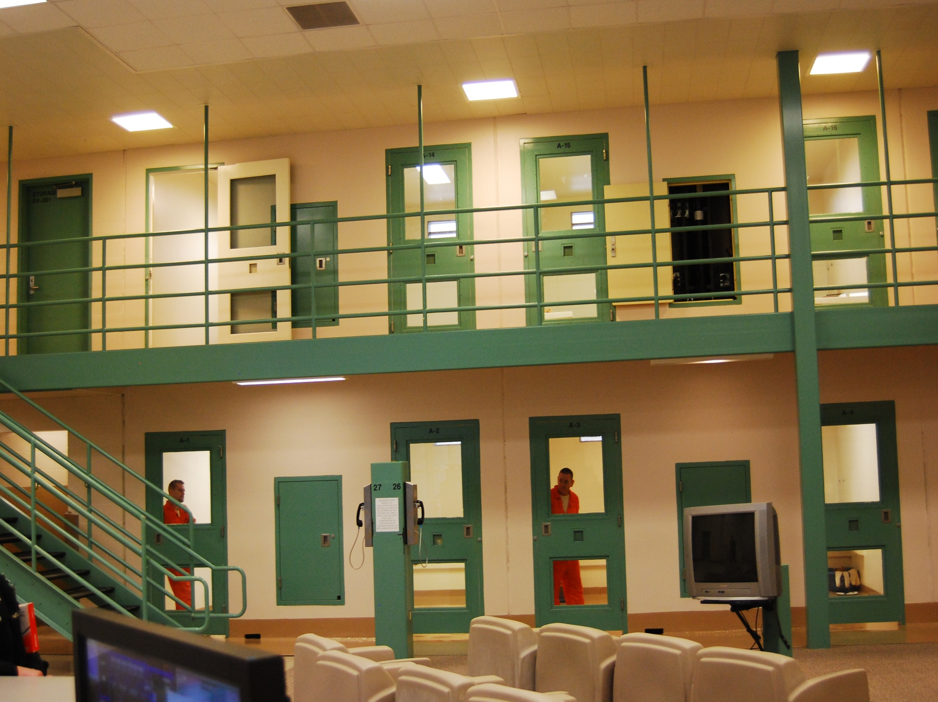
Housing Facility

Slide 9
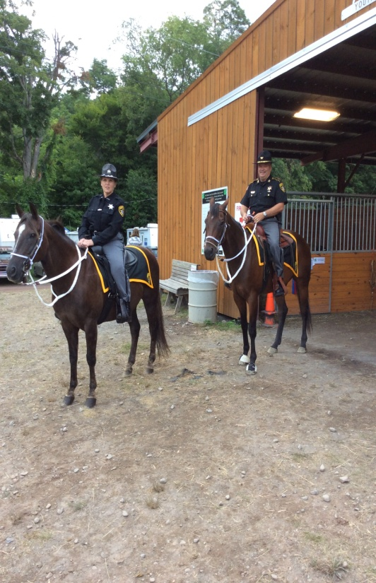
Law Enforcement Division
Smallest Law Enforcement Division in the State; (10) Deputies as compared to Chenango (23) Otsego (12) and Schoharie (12).
Fully Accredited by the NYS Division of Criminal Justice Services.
6,829 Calls for Service – Up 20%
1,418 Emergency-911 Calls Answered – Up 35%.
3,228 Cases Opened – Up 158%
233,875 Miles of Road Patrolled
408 Arrests – Up 36% (Up 36% in 2012)
Felonies – Up 20%
Misdemeanors – Up 24%
Violations and Traffic Tickets– 824 (1596 in 2012)
430 Motor Vehicle Accidents – Up 19%

Slide 10
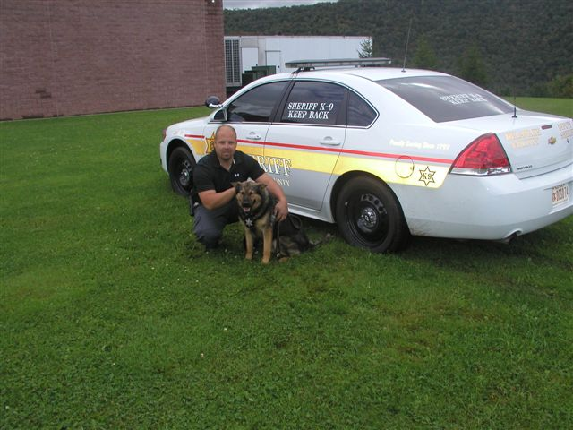
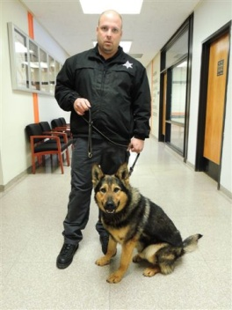
Drug Enforcement Unit
In 2013 the Sheriff’s Drug Enforcement Unit made great strides in the eradication of illicit drugs from our County.
(49) Felony-Level Drug Dealer Arrests – Up 30% (227% in 2012)
Significant amount illicit drugs removed from our Communities
Re-assignment of (1) Deputy Sheriff to CID to work exclusively on drug cases.
Certified K-9 Narcotics Team to CID
DCSO Responsible of 53% of all Felony-Level Drug Cases Introduced in Delaware County Court (NYSP 30%).
(53) Felony-Level Drug cases as of August 2014.

Slide 11
Drug Dealing Trends
2013
(13) Heroin Buys
(6) Cocaine Buys
(5) Suboxone Buys
(2) Felony Marihuana Buys
(16) Prescription Narcotics Buys
2014 *As of August
(28) Heroin Buys
(12) Cocaine Buys
(3) Suboxone Buys
(9) Prescription Narcotics Buys

Slide 12
Sex Offender Registry
The Sheriff’s Criminal Investigation Division monitors and tracks all convicted sex offenders residing in Delaware County.
(117) Current Sex Offenders (29% Increase):
(29) Level-3 *Most Serious
(41) Level-2
(47) Level-1

Slide 13

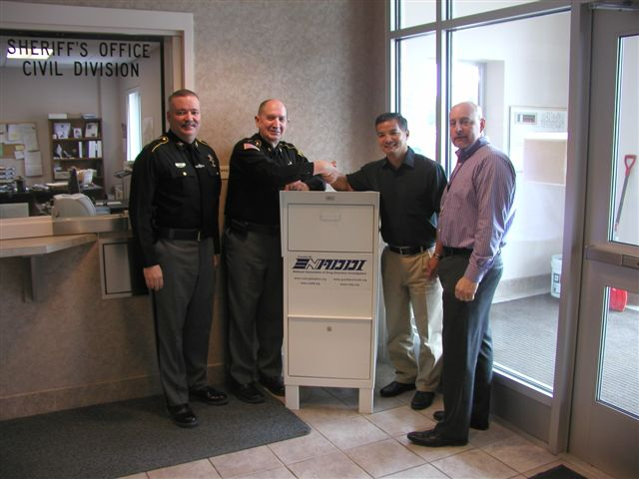
Accomplishments - 2013
Significant Illicit Drug Enforcement
Initiated Delaware County Drug Task Force
Sheriff’s TIP Line
Sheriff’s Smart-Phone App.
Sheriff’s Drug Drop Box
Certification of K9 Narcotics/Patrol/Search
Sick Leave Reduction Program
Reduced the use of Sick Leave by 1,060 Hours or 24% resulting in a $20,328.00 savings to the County. ($49,703.00 in 2012)

Slide 14
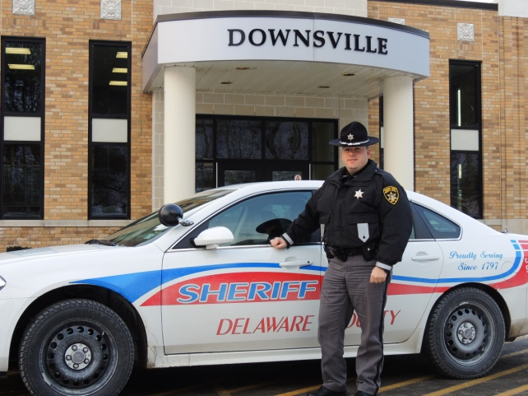
Sheriff’s School Resources Officer
Sheriff’s Substations in (4) Delaware County Schools- Stamford, Downsville, Franklin, and Deposit.
Dedicated Deputy Sheriff in 2015

Slide 15
Historical Tidbits
The Office of the Sheriff has been in existence since the 9th Century; since 1797 in Delaware County.
Sheriff Thomas E. Mills is the 58th Delaware County Sheriff.
The Sheriff is the only constitutional law enforcement officer in the land and the Office is vital to our republic.
The Office of Sheriff is the oldest law-enforcement entity in the history of the world. The term “Sheriff” derived from early England where the Counties were referred to as “Shires” and the Keeper of the Peace known as the “Reeve”.
The Sheriff does not answer to the government but rather the citizens who elect him into Office. This was cleverly designed to prevent a tyrannical or overreaching government.
The Sheriff is accountable directly to the people who elect him into Office and thus is considered the citizen’s last line of defense or “The People’s Law Man”.

Slide 16
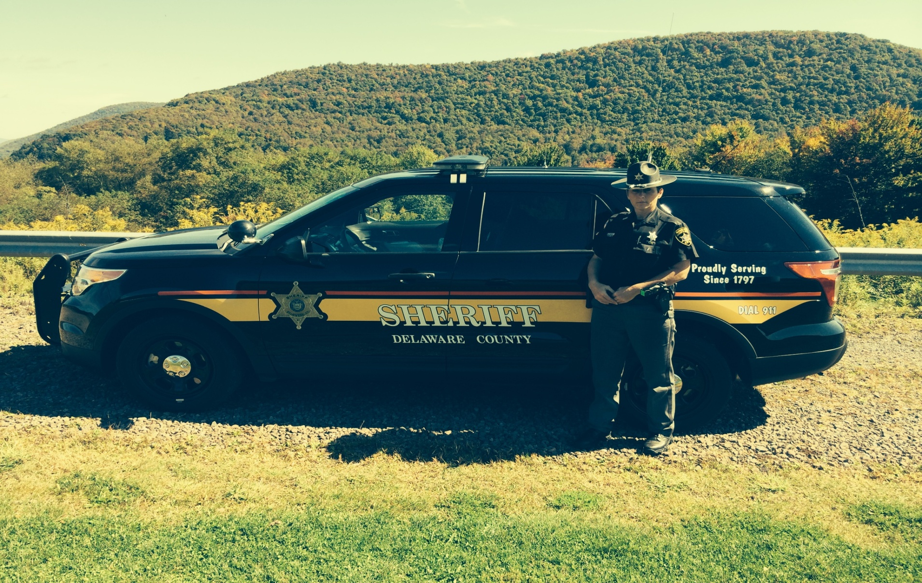
Questions?
Deputy Kim Smith

